Slide 1
Heart Transplantation in CHD patients with Heterotaxy Syndrome
Writing Group Members:
Asma Khan, Ann & Robert H. Lurie Children's Hospital of Chicago
Melanie Everitt, Children’s Hospital Colorado Heart Institute
Elfi Pahl, Ann & Robert H. Lurie Children's Hospital of Chicago
James Kirklin, University of Alabama at Birmingham
Devin Koehl, University of Alabama at Birmingham
Ryan Cantor, University of Alabama at Birmingham
Paolo Rusconi, University of Miami, Jackson Memorial Hospital
Estela Azeka, Heart Institute (InCor) University of São Paulo Medical School
Aliessa Barnes, Children's Mercy Hospital and Clinics
Susan Blensdorf, Ann & Robert H. Lurie Children's Hospital of Chicago

Slide 2
Proposal - Background
Congenital heart disease (CHD) continues to remain an important indication for transplantation. In the current era, CHD patients undergoing transplant as primary therapy are a diverse group and include lesions such as HLHS patients who are not candidates for Norwood palliation, infantile Ebstein anomaly, PA/IVS with severe coronary anomalies and complex heterotaxy lesions with functional single ventricles. Transplantation is in addition also performed for CHD patients with previous corrective biventricular repairs, previously palliated single ventricle patients who are not candidates for Fontan completion, and lastly for a growing population of patients with failing Fontan physiology.
Reports based on both ISHLT and UNOS databases have consistently indicated that transplantation in CHD patients with or without previous surgical palliation or repair is associated with worse outcomes (1-3). However, there is insufficient literature looking at detailed subgroup analysis on transplant outcomes for different types of CHD lesions. Previous studies comparing outcomes after HLHS vs other types of CHD have shown that HLHS patients have worse outcomes, indicating that pre-transplant diagnosis has an impact on post-transplant survival (2). Another study identified un-operated Non-HLHS infants as a high risk group (3). Worse outcomes in CHD patients could be from a combination of factors. For instance, disease specific factors such as association of certain lesions with genetic syndromes and inherent comorbidities likely play a role in post transplant outcomes. Patients with certain CHD lesions may have other perioperative risk factors that impact outcomes, such as increased need for ICU management and ventilator or ECMO/VAD dependence. Several other factors could potentially affect post-transplant outcomes, including previous surgeries with exposure to blood products and increased sensitization, and possibly increased donor ischemic time in patients with multiple prior sternotomies and in patients complex heterotaxy lesions with abnormal connections, making transplant a technically more challenging procedure.
Visceral ‘Heterotaxy’, also referred to as isomerism, is a special group of developmental defects defined by abnormal laterality or sidedness of thoracoabdominal viscera. These defects are usually associated with spleen abnormalities and often are also associated with complex CHD. This represents an interesting and heterogenous group of CHD patients, with a very diverse group of lesions. Interestingly, patients with heterotaxy have been shown to have unexplained worse outcomes in a wide range of surgical settings. A recent review of the STS database reported a higher discharge mortality for patients with Single ventricle with heterotaxy when compared to SV patients without heterotaxy after systemic to pulmonary shunts (10.8% vs 6.6%) and after Fontan procedure (4.2% vs 1.8%) (4). Patients undergoing TAPVR repair in association with heterotaxy have similarly been shown to have worse outcomes, with increased re-operations for pulmonary vein stenosis and overall worse survival (5-7).
There is insufficient data on outcomes after listing for cardiac transplantation in patients with heterotaxy syndrome. One small single institution report of experience with cardiac transplantation in CHD patients found that heterotaxy is associated with worse post transplant survival (8). Larsen et al described their experience with cardiac transplantation in 29 children with heterotaxy syndrome and found a trend for worse survival compared to patients with cardiomyopathy as well as a higher incidence of rejection (9). These results however did not reach statistical significance, possibly due to the small size of the cohort.
The reason for worse outcomes in hetrotaxy population is likely multi-factorial. For instance, CHD patients with heterotaxy have been shown to have more respiratory complications (10). This has been hypothesized to be linked to ciliary dysfunction similar to that seen in primary ciliary dyskinesia, resulting in a predisposition to respiratory complications. Additionally, functionally asplenic patients, especially those less than 5 years of age, are also believed to be more susceptible to infections with encapsulated organisms. These factors could contribute to worse outcomes in CHD patients with heterotaxy.

Slide 3
Proposal – Study Rationale
The association of heterotaxy with worse post-operative outcomes has been established in a wide range of surgical settings as described above. However, we do not have sufficient data to accurately predict outcomes after listing for transplantation in this patient population. While small single institution studies have shown that visceral heterotaxy may be associated with worse outcomes, these studies are limited by their small cohort size. Waitlist mortality for pediatric heart transplantation unfortunately remains high, especially in high risk groups such as infants and patients with congenital heart disease. It is important to identify high risk patient populations, so efforts can be made to mitigate these risks where possible

Slide 4
Proposal - Hypothesis / Specific Aims:
The aim of this study is to describe outcomes after listing for cardiac transplantation in CHD patients with heterotaxy syndrome when compared to non-heterotaxy CHD and cardiomyopathy (CM) patients as well as post transplant outcomes.
Hypothesis 1: Patients with diagnosis of CHD with heterotaxy have worse outcomes post- listing than patients with non-heterotaxy CHD or patients with CM
Hypothesis 2: Patients with diagnosis of CHD with heterotaxy have worse post transplant outcomes than patients with non-heterotaxy CHD or patients with CM
Specific Aim 1:
Describe outcomes after listing for cardiac transplantation (death/transplantation/ alive on the list/ upgrade of UNOS status due to clinical deterioration) in CHD patients with heterotaxy syndrome when compared to non-heterotaxy CHD and cardiomyopathy patients.
Specific Aim 2:
Describe post transplant outcomes in CHD with heterotaxy patients vs non-heterotaxy CHD and cardiomyopathy groups. Outcomes after transplant to be studied include graft loss (death or retransplantation), rejection, CAV, PTLD and infection after transplant.

Slide 5
Proposal – Data Collection:
Study population:
All eligible pediatric patients (<18 years) enrolled in the Pediatric Heart Transplant Study (PHTS) database, who were listed for transplant between Jan 2010 to Dec 2016 will be included in the study.
The classification ‘isomerism’ was added to the PHTS collection forms in Jan 2010 and will be used to identify CHD patients with heterotaxy.
This analysis will be from 1993-2018

Slide 6
PHTS 2018 Research Cohort
This is the overall research cohort from which our
study cohort will be derived.
Listings
January 1, 1993 – December 31, 2018
N = 9204
Died on Waitlist
N = 1288
14%
Removed From List
N = 719
8%
Alive on List*
N = 524
6%
Transplant
n = 6673
73%
Death after Transplant
N = 1481
22%
Alive*
N = 5192
78%
*149 censored at transfer
Research cohort includes patients whose first ever listing was their recorded in PHTS
Detailed information on re-lisitng and retransplants are collected in the registry
These analyses are based on waitlist outcomes for 1st listing and transplant characteristics for patient's first transplant
Currently using the August build, in the process of incorporating a registry level cleanup of CHD Other Specify
*1789 censored at post-transplant transfer
Notes:
Updated 3/6/2019

Slide 7
PHTS 2018 Research Cohort Waitlist Follow-up (First Listing)
Time Zero Date of listing
Events Transplant, death, removal from list
Censoring Transfer, study close date
Patients 9204
Total Follow-up 47,798.63 patient-years
Mean ± STD 5.2 ± 11.4 months
Median (p25-p75) 1.8 (0.7-4.5) months
Notes:
Updated 3/6/2019

Slide 8
PHTS 2018 Research Cohort Post-Transplant Follow-up (Patient Level)
Time 0 Date of 1st transplant
Events Death
Censoring Post-Transplant Transfer, Study close date
Patients 6673
Total Follow-up 36,788 patient-years
Mean ± STD 5.5 ± 5.3 years
Median (p25-p75) 4.0 (1.3-8.1) years
Notes:
Updated 3/6/2019

Slide 9
Defining Heterotaxy
Define Heterotaxy Indicator
Implement
Review
Patient summary of all relative details for heterotaxy pts and for relative details for non-heterotaxy
Finalize
Update statistical analysis

Slide 10
Defining the Heterotaxy Indicator
HETEROTAXY (0,1) = 1
Medical history heterotaxy/ isomerism (8a HXISO = 1)
If Medical history other specify (SPECOTH) contains any mention of Asplenia or Polysplenia: (“Asplenia”, “Asplenia, Cleft Lip Thrombosis”, “Asplenic”, “Asplenia, malrotation”) then they are flagged as a heterotaxy patient.
We may need to update the history of isomerism flag accordingly
CHD diagnosis of heterotaxy (CHD_HETER = 1)
If CHD Other Specify text (CHD_OTHSP) for heterotaxy, asplenia or polysplenia, then then they are flagged as a heterotaxy patient.
We may need to update the CHD heterotaxy flag accordingly
Notes:
Could make a ISOMERISM (0,1) indicator and a HETEROTAXY (0,1) indicator

Slide 11
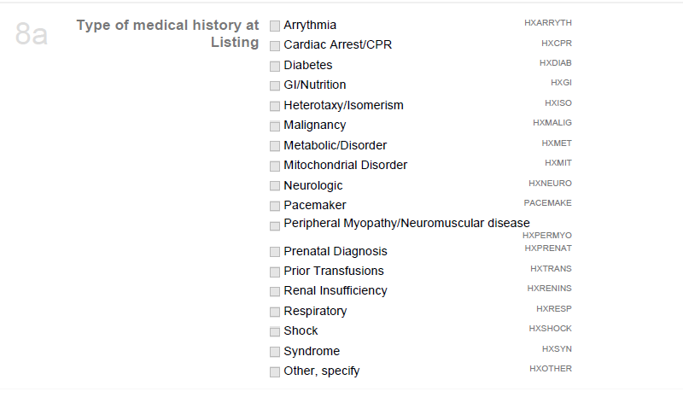
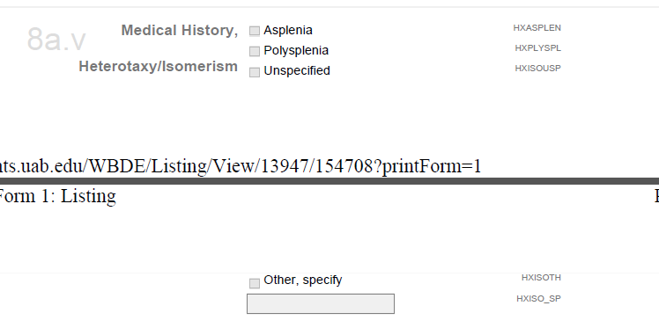
Medical History at Listing: Heterotaxy/Isomerism

Slide 12
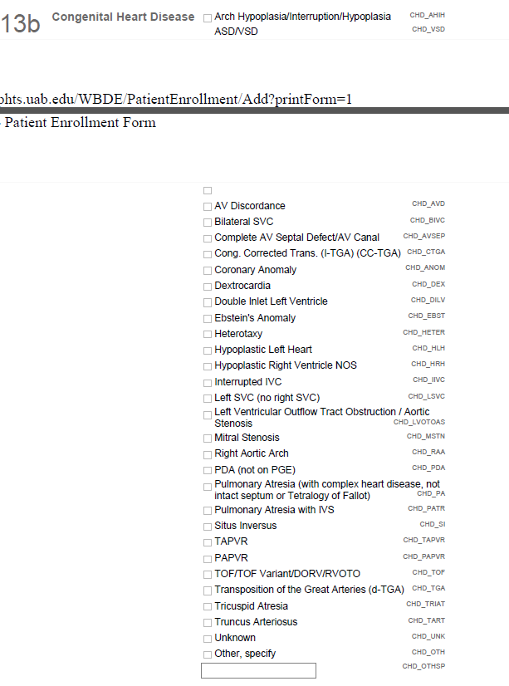
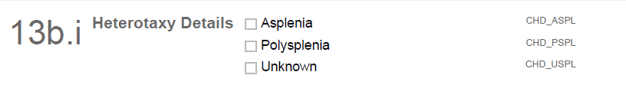
Type of CHD: Heterotaxy
*Currently flagging these
patients to be in the
heterotaxy comparison group

Slide 13
PHTS 2019 Analysis Cohort
Listed Patients
January 1, 1993 – December 31, 2018
N = 9204
Congenital Heart Disease
N=4826 (52%)
Non-Congenital Heart Disease*
N=4377 (48%)
Heterotaxy
N=181 (4%)
Non-Heterotaxy
N=4645 (96%)
Transplant
N=120
T
Transplant
N=3150
Cardiac Tumor (n=32)
Cardiomyopathy (n=4023)
Myocarditis (n=313)
Other, Specify (n=9)
1 patients missing diagnosis

Slide 14
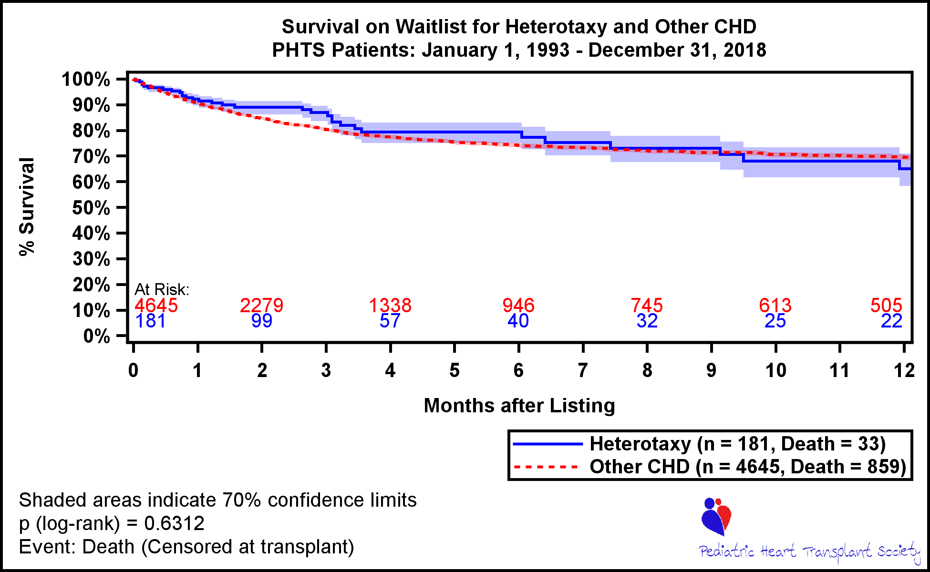
Survival on Waitlist

Slide 15
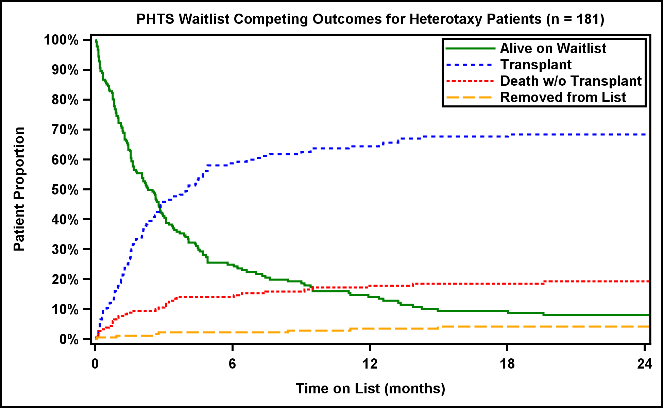
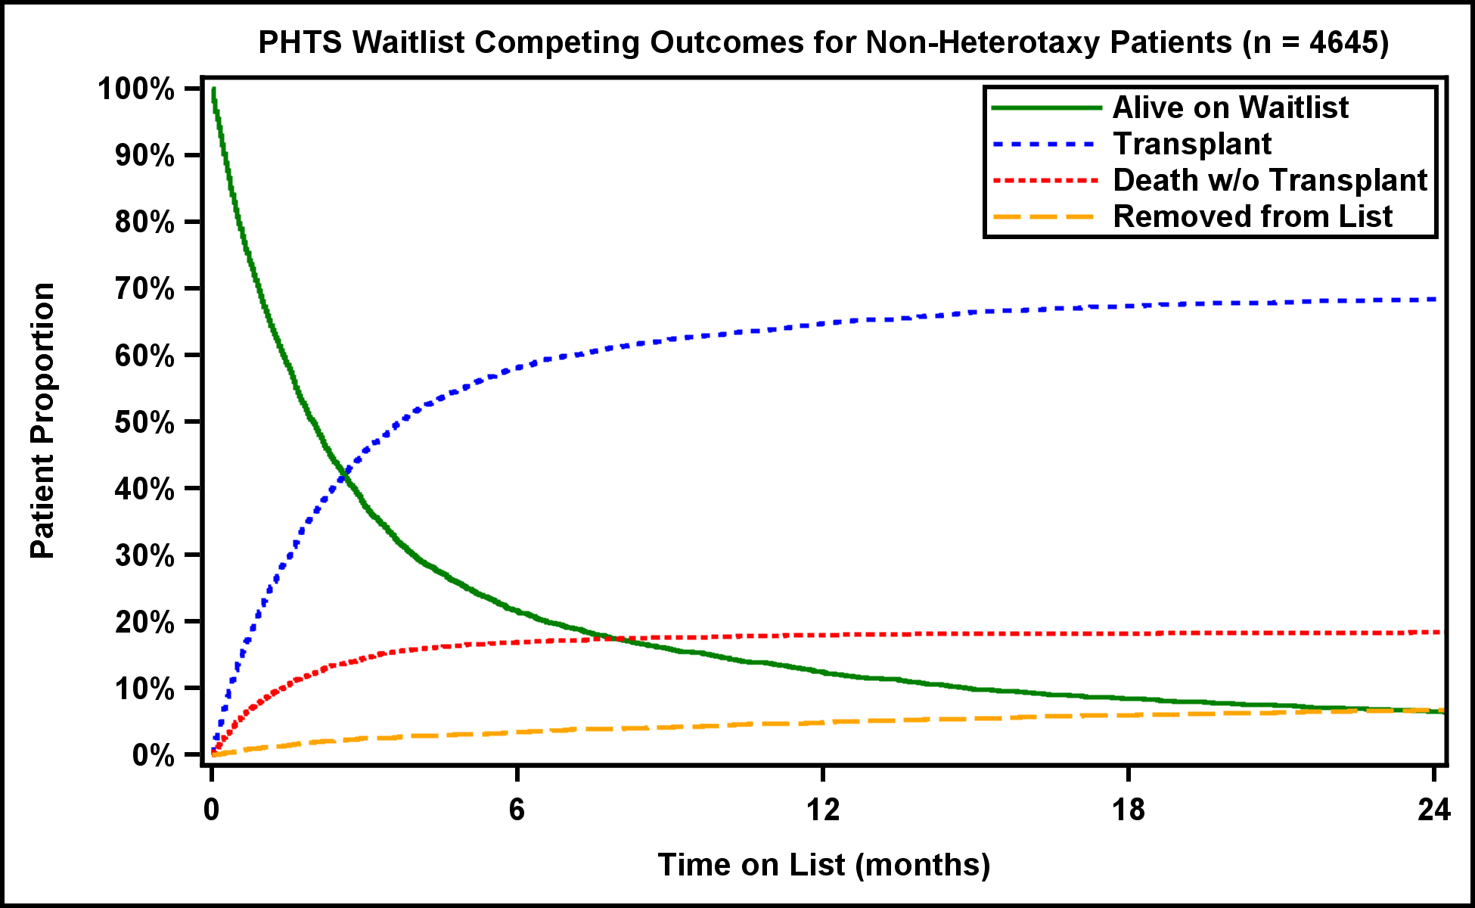
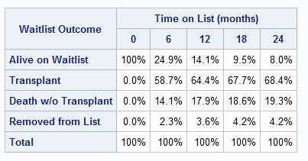
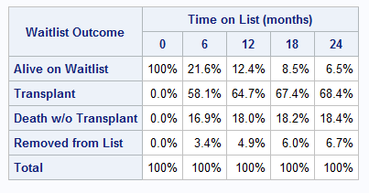
Competing Outcomes

Slide 16
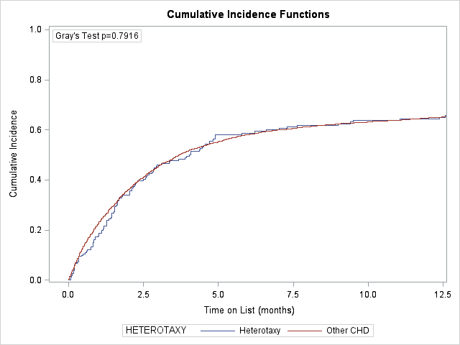
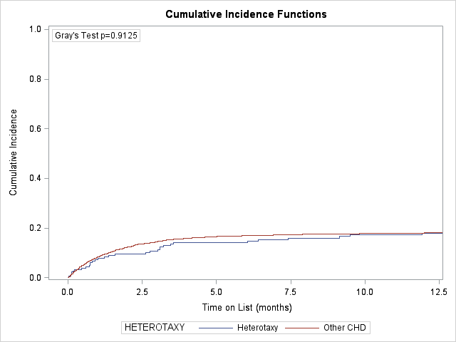
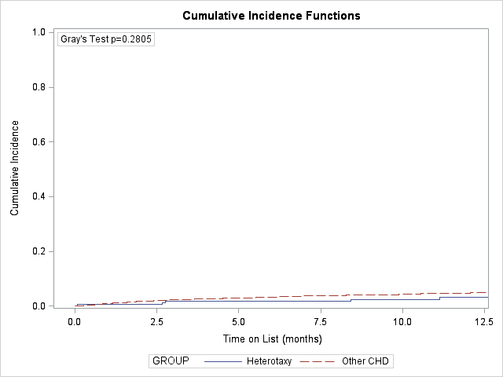
Comparing Competing Outcomes by Heterotaxy Group
Transplant
Death
Removal from List

Slide 17
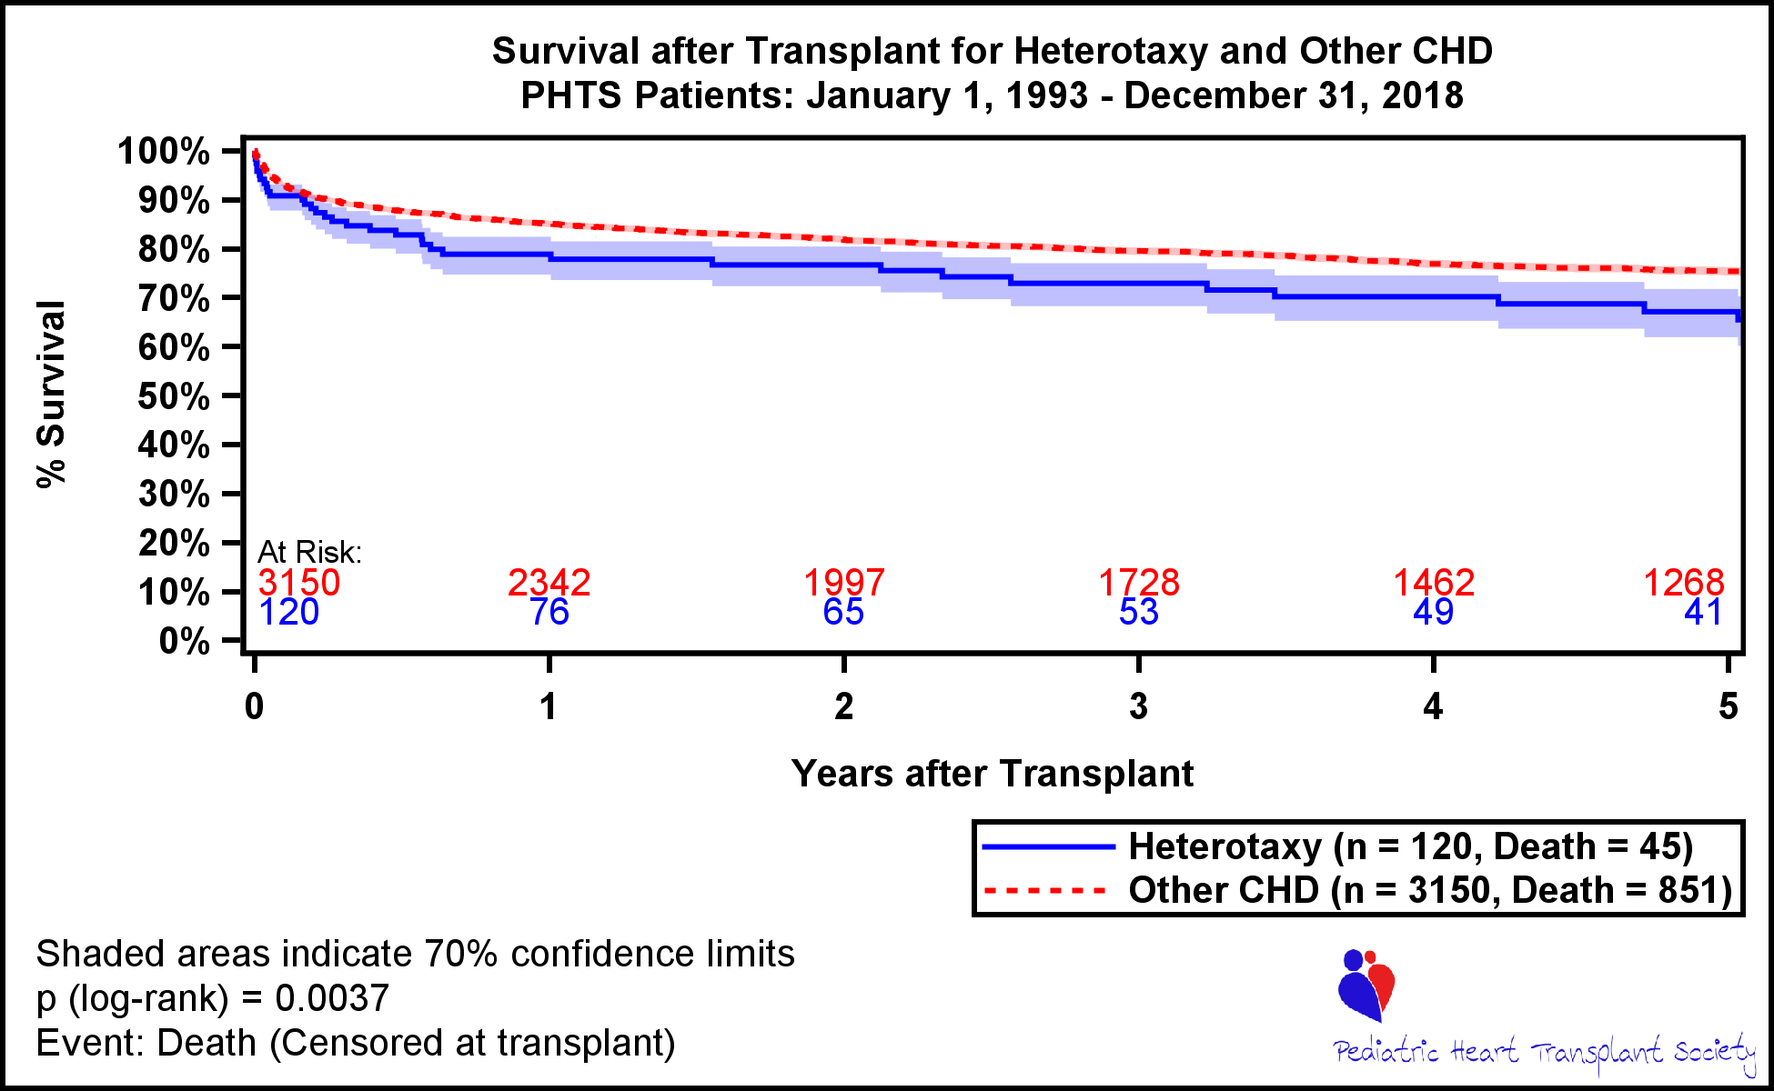
Patient Survival after Transplant

Slide 18
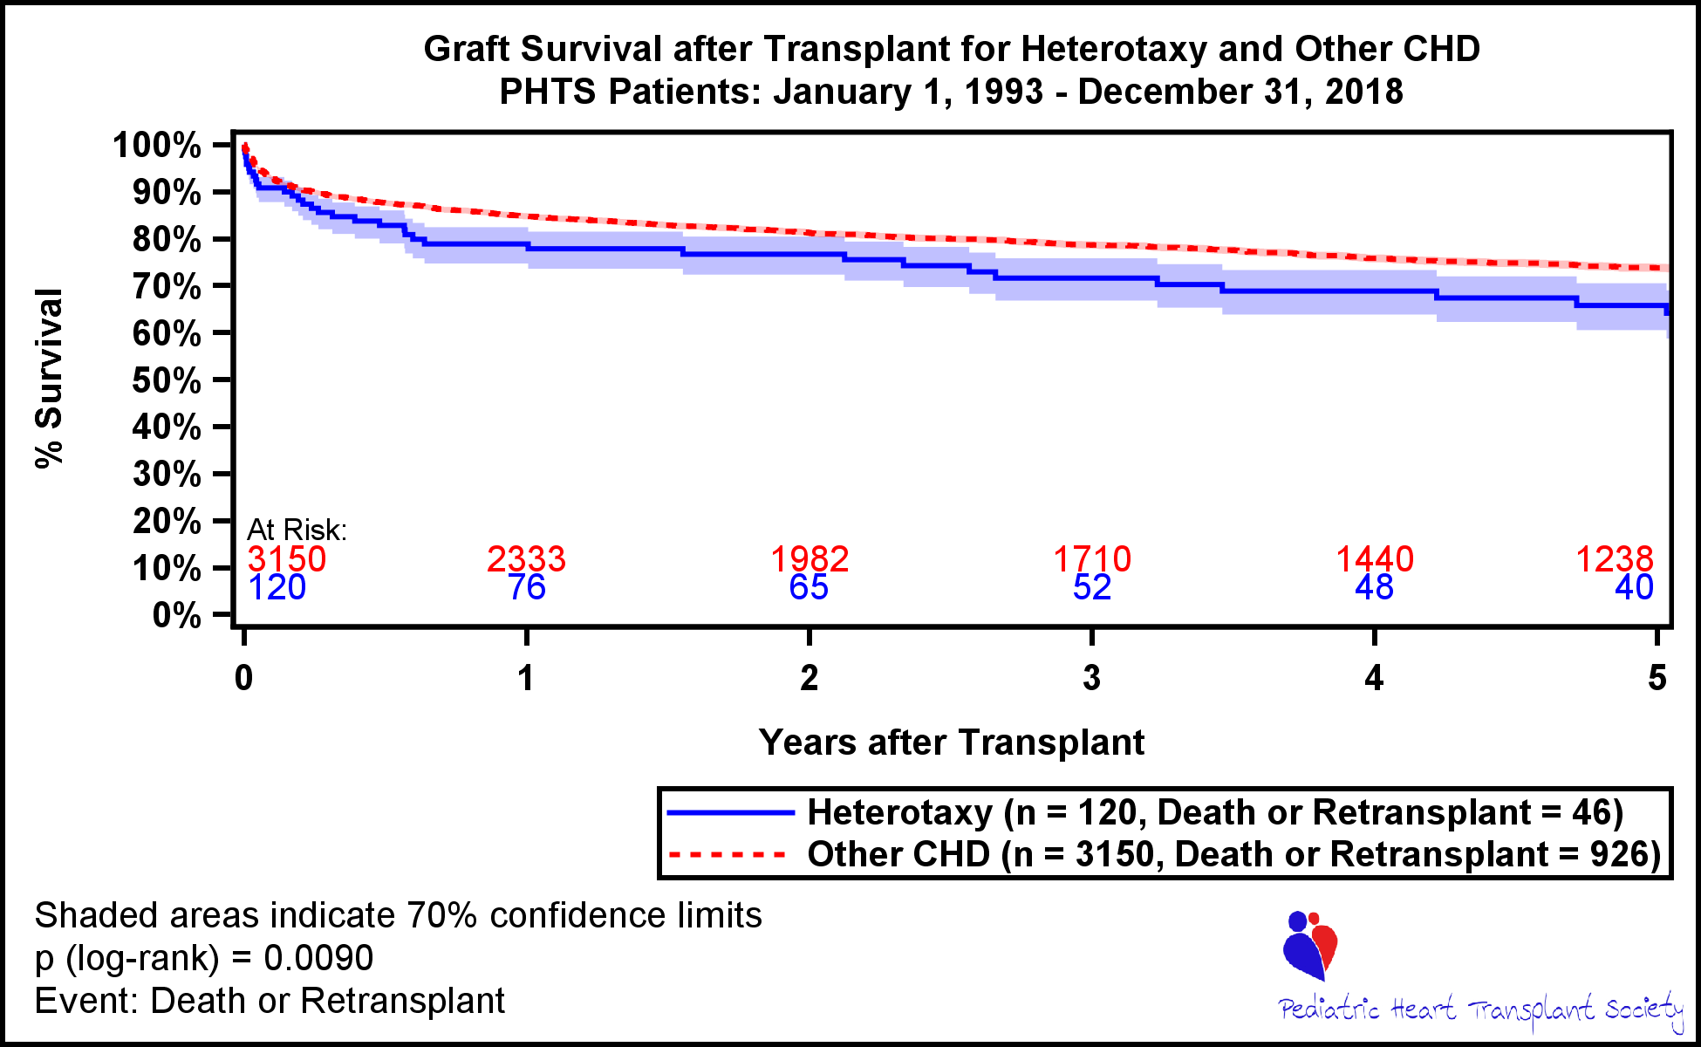
Graft Survival after Transplant

Slide 19
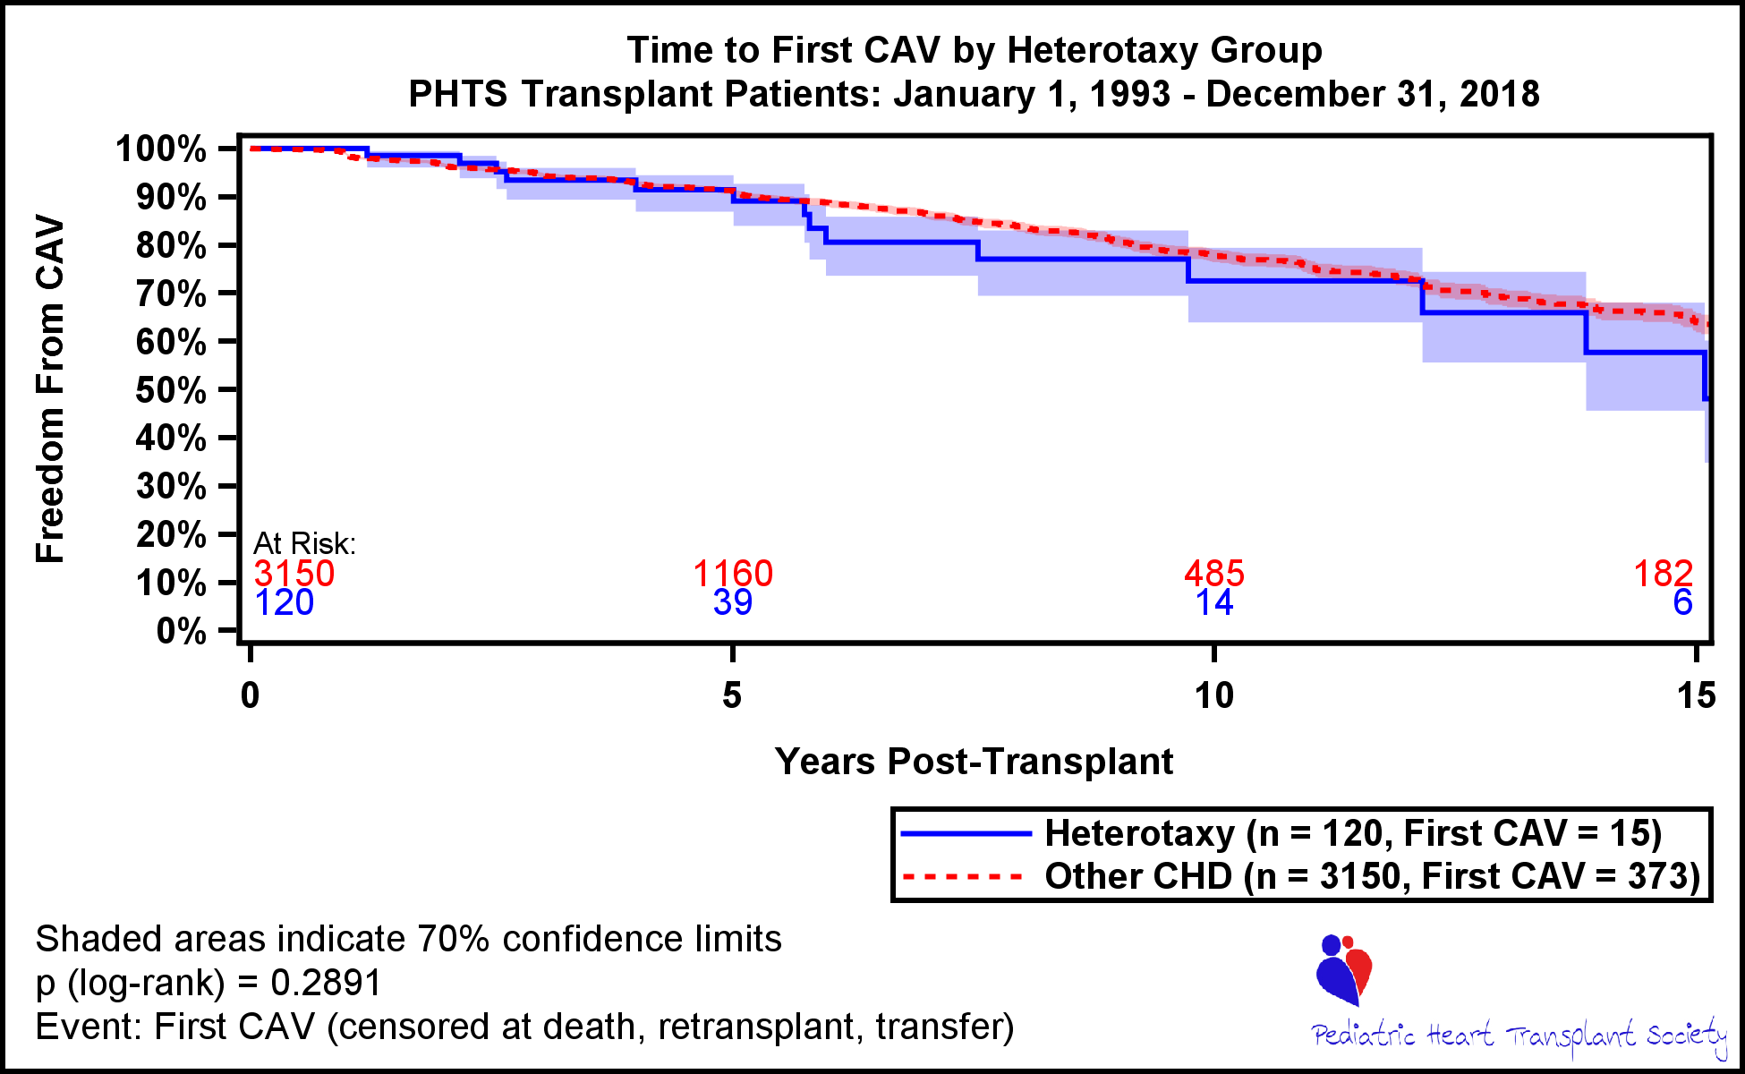
Time to first CAV

Slide 20
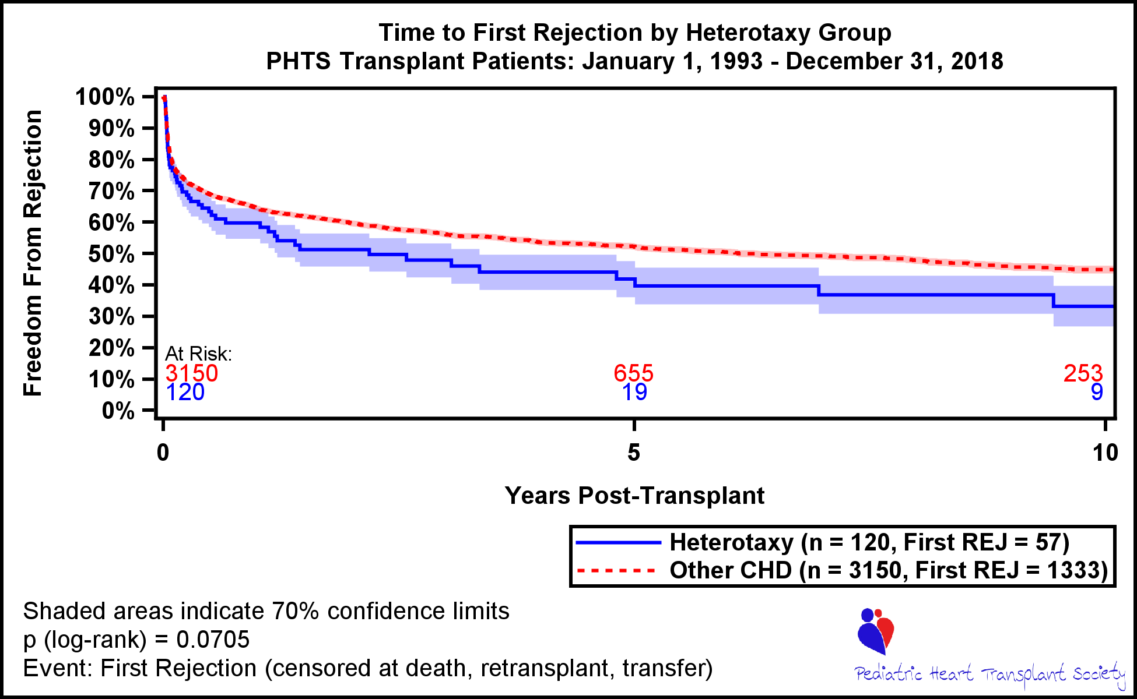
Time to first Rejection

Slide 21
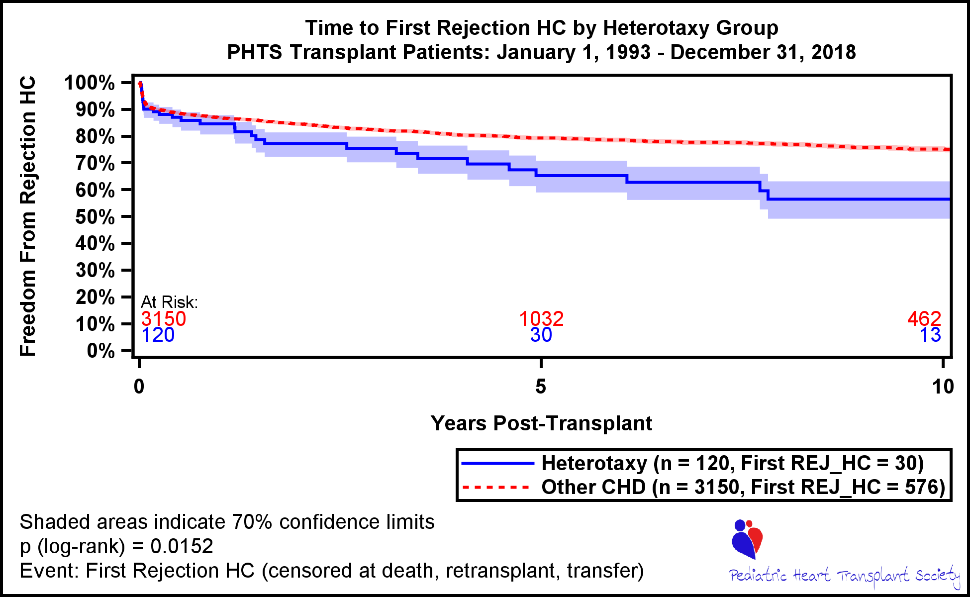
Time to first HC Rejection

Slide 22
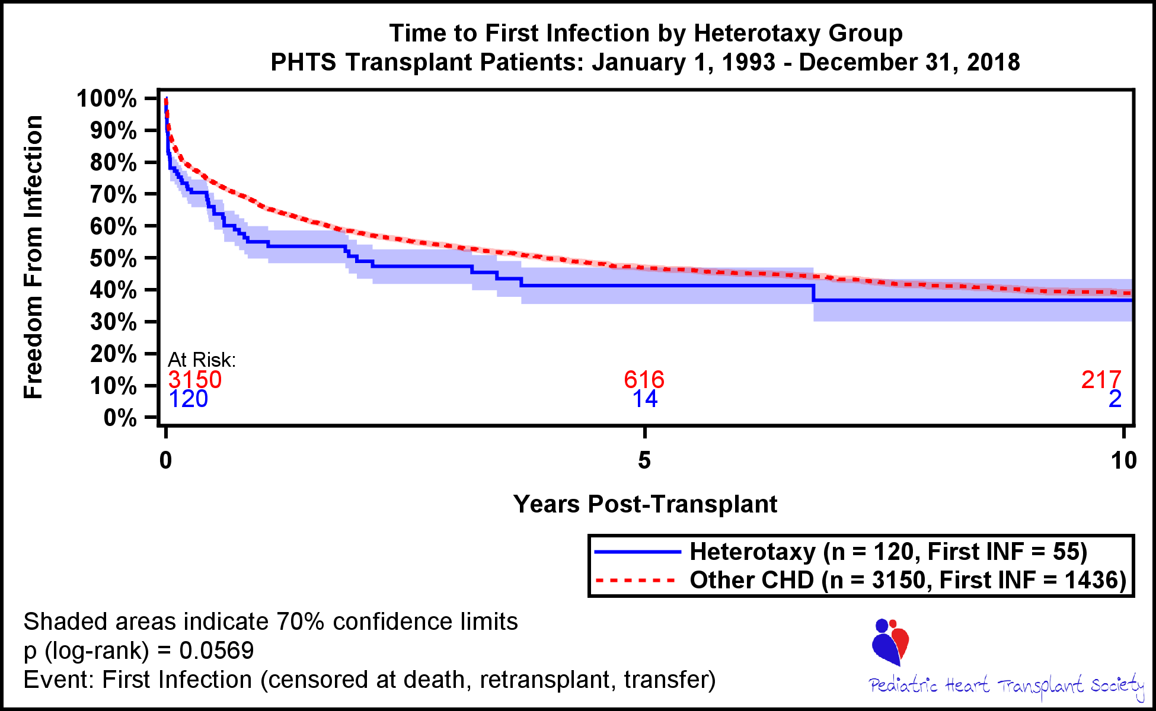
Time to first Infection

Slide 23
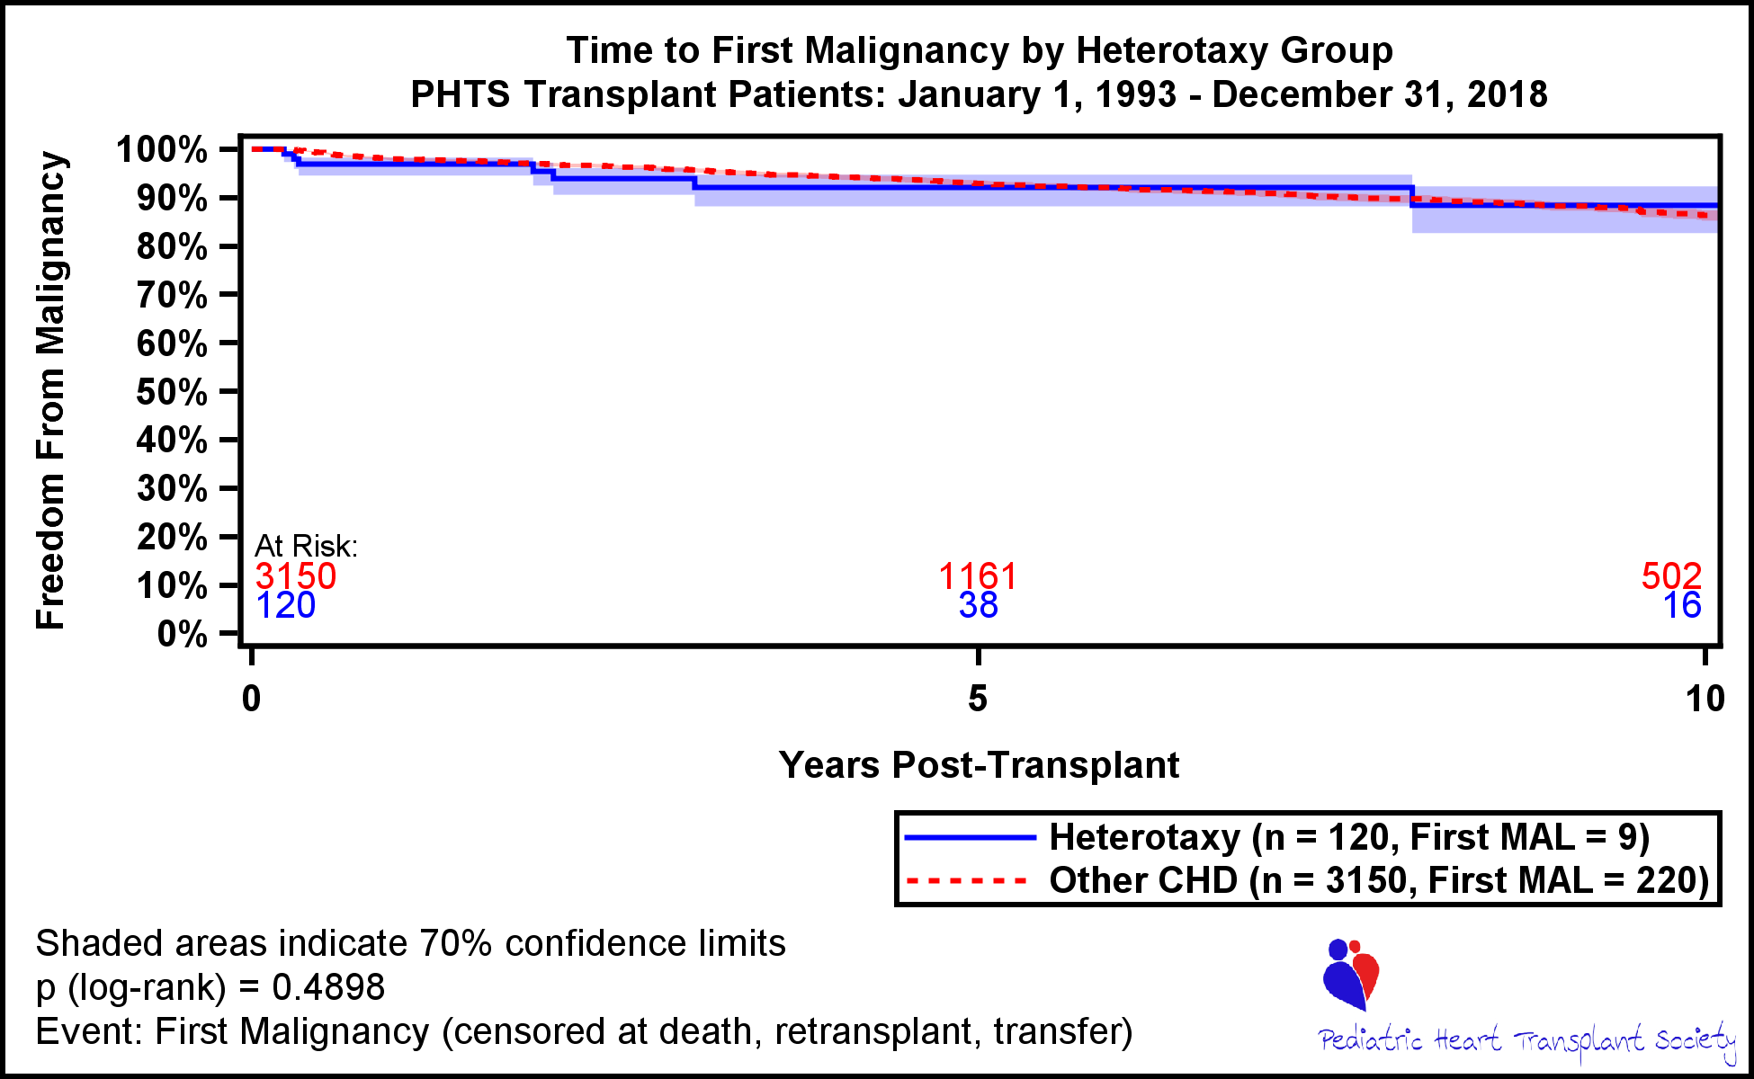
Time to first Malignancy

Slide 24
Table 1: Type of Heterotaxy
*Can every heterotaxy patient be categorized as asplenia or polyspenia?
If they answer Medical History or CHD Heterotaxy but left the other unknown, we listen to the
Answered question
Medical History | Isomerism n=181
Asplenia | 90
Polysplenia | 26
Unspecified | 65
*New table
Medical History | Isomerism n=75
Asplenia | 46
Polysplenia | 18
Situs Ambiguous | 4
Situs Ambiguous and Asplenia | 4
Situs Ambiguous and Polysplenia | 1
Unspecified | 2
*How were these defined?

Slide 25
Table 2: Characteristics by Etiology at Listing
Patient Characteristics at Listing | Heterotaxy (n= 181) | Other CHD (n= 4645) | p-value
Male | 99 (54.7) | 2828 (60.9) | 0.0946
White | 119 (65.7) | 3425 (73.7) | 0.0170
UNOS Status at Listing |  |  | 0.0003
1 | 19 (11.3) | 558 (13.1)
1A | 77 (45.8) | 2426 (57.1)
1B | 18 (10.7) | 476 (11.2)
2 | 54 (32.1) | 776 (18.3)
7 |  | 11 ( 0.3)
History of Surgery at Listing | 154 (85.1) | 3628 (78.2) | 0.0266
Ventillator at Listing | 33 (20.9) | 1265 (29.2) | 0.0237
VAD at Listing | 2 ( 1.1) | 96 ( 2.1) | 0.3681
ECMO at Listing | 7 ( 3.9) | 353 ( 7.6) | 0.0608
Renal Failure at Listing (eGFR < 60) | 21 (19.6) | 692 (27.6) | 0.0710
History of Renal Insufficiency | 4 ( 2.2) | 212 ( 4.6) | 0.1265
Age at Listing (y) | 5.8 +/- 5.7 (n= 181) | 4.2 +/- 5.5 (n= 4645) | <.0001
PRA > 10 | 15 (20.8) | 637 (30.6) | 0.0763
Notes:
Add single ventricle flag to this table

Slide 26
Table 3
Patient Characteristics at Transplant | Heterotaxy (n= 120) | Other CHD (n= 3150) | p-value
Male | 59 (49.2) | 1913 (60.7) | 0.0111
White | 80 (66.7) | 2355 (74.8) | 0.0459
UNOS Status at Transplant |  |  | 0.0006
1 | 10 ( 9.0) | 362 (12.6)
1A | 62 (55.9) | 1942 (67.7)
1B | 16 (14.4) | 275 ( 9.6)
2 | 23 (20.7) | 289 (10.1)
History of Surgery at Listing | 102 (85.0) | 2471 (78.5) | 0.0874
Ventillator at Transplant | 21 (18.8) | 670 (23.0) | 0.2981
VAD at Listing | 2 ( 1.7) | 59 ( 1.9) | 0.8698
VAD at Transplant | 4 ( 3.4) | 199 ( 6.7) | 0.1653
ECMO at Listing | 1 ( 0.8) | 164 ( 5.2) | 0.0317
ECMO at Transplant | 2 ( 1.7) | 219 ( 7.4) | 0.0205
Renal Failure at Transplant (eGFR < 60) | 27 (23.7) | 763 (25.1) | 0.7293
History of Renal Insufficiency | 2 ( 1.7) | 132 ( 4.2) | 0.1688
Induction Therapy | 88 (73.3) | 2347 (75.1) | 0.6645
Age at Transplant (y) | 6.5 +/- 5.9 (n= 120) | 5.0 +/- 5.8 (n= 3150) | 0.0049
Donor Ischemic Time (minutes) | 244.2 +/- 87.9 (n= 116) | 236.0 +/- 78.0 (n= 3078) | 0.2741
PRA at Transplant > 10 | 15 (21.7) | 618 (30.4) | 0.1213
Notes:
Add single ventricle flag

Slide 27
Table 4: Risk Factors for Post-Transplant Mortality in CHD Patients
Still need to add steroids to the model
PHASE | VARIABLE | VAR_LABEL | HR | LCL_95 | UCL_95 | P
Early | ECMO | ECMO at Transplant | 3.139 | 2.355 | 4.185 | <.0001
Early | VAD | VAD at Transplant | 1.566 | 1.049 | 2.338 | 0.0282
Early | MALE | Male | 0.807 | 0.654 | 0.996 | 0.0455
Early | INDTHER | Induction Therapy at Transplant | 0.548 | 0.442 | 0.680 | <.0001
Early | RENAL | Renal Failure at Transplant | 1.704 | 1.366 | 2.125 | <.0001
Early | TXVENT | Ventilator at Transplant | 1.379 | 1.078 | 1.763 | 0.0106
Constant | HETERO | Heterotaxy | 1.794 | 1.174 | 2.741 | 0.0069
Constant | HXSURG | History of Surgery | 1.536 | 1.179 | 2.003 | 0.0015
Constant | RRACE_B | Receipient Race - Black | 1.906 | 1.492 | 2.437 | <.0001
Constant | STATUS1 | Status 1 at Transplant | 0.573 | 0.459 | 0.716 | <.0001
Notes:
Add single ventricle to model

Slide 28
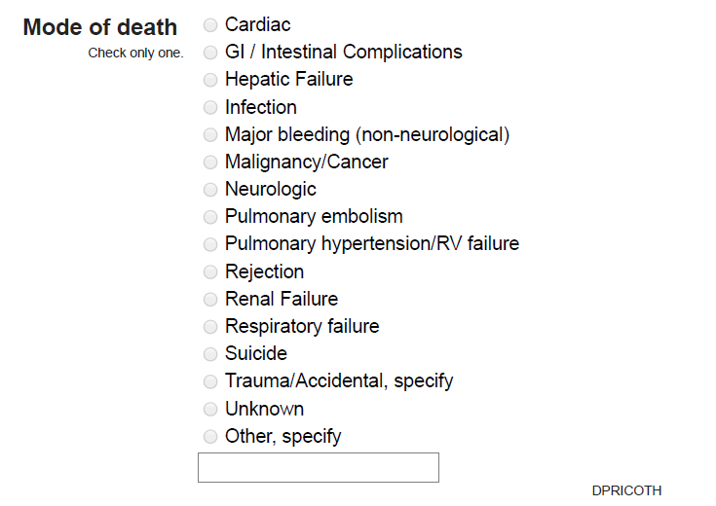
Table 5: Cause of Death Table
Primary Cause of Death | Heterotaxy Deaths n=78 |  | Other CHD Deaths n=1710
 | Waitlist n=33 | Post-Transplant n=45 | Waitlist n=859 | Post-Transplant n=851
Cardiac | 23 | 19 | 481 | 322
Infectious | 1 | 5 | 43 | 103
Others | 9 | 21 | 335 | 426
*How to group into these categories?
Currently only “Cardiac” gets into Cardiac, “Infection” gets into “Infectious” and every other COD is grouped into “Others”
Could potentially create an RTF that shows COD by group and includes other specify text for review and potential regrouping
Notes:
Cardiac has rejection, RV Failure/pulmonary hypertension

Slide 29
Table 6
Patient Characteristics at Listing | Asplenia (n= 90) | Polysplenia (n= 26) | p-value
Male | 53 (58.9) | 6 (23.1) | 0.0013
White | 61 (67.8) | 17 (65.4) | 0.8189
UNOS Status at Listing |  |  | 0.1589
1 | 9 (11.1) | 7 (28.0)
1A | 32 (39.5) | 8 (32.0)
1B | 10 (12.3) | 1 ( 4.0)
2 | 30 (37.0) | 9 (36.0)
History of Surgery at Listing | 79 (87.8) | 19 (73.1) | 0.0682
Ventillator at Listing | 10 (13.5) | 7 (30.4) | 0.0623
VAD at Listing | 2 ( 2.2) | 0 ( 0.0) | 0.4432
ECMO at Listing | 2 ( 2.2) | 1 ( 3.8) | 0.6459
Renal Failure at Listing (eGFR < 60) | 6 (12.2) | 5 (29.4) | 0.1017
History of Renal Insufficiency | 3 ( 3.4) | 1 ( 3.8) | 0.9074
Age at Listing (y) | 6.3 +/- 5.6 (n= 90) | 4.7 +/- 5.9 (n= 26) | 0.2036
PRA > 10 | 7 (25.9) | 3 (27.3) | 0.9319

Slide 30
Table 7
Patient Characteristics at Transplant | Asplenia (n= 54) | Polysplenia (n= 17) | p-value
Male | 25 (46.3) | 4 (23.5) | 0.0958
White | 37 (68.5) | 11 (64.7) | 0.7696
UNOS Status at Transplant |  |  | 0.3362
1 | 4 ( 8.5) | 4 (23.5)
1A | 23 (48.9) | 8 (47.1)
1B | 8 (17.0) | 1 ( 5.9)
2 | 12 (25.5) | 4 (23.5)
History of Surgery at Listing | 47 (87.0) | 13 (76.5) | 0.2937
Ventillator at Transplant | 7 (14.0) | 4 (25.0) | 0.3041
VAD at Listing | 2 ( 3.7) | 0 ( 0.0) | 0.4209
VAD at Transplant | 2 ( 3.8) | 0 ( 0.0) | 0.4164
ECMO at Transplant | 1 ( 1.9) | 0 ( 0.0) | 0.5684
Renal Failure at Transplant (eGFR < 60) | 9 (18.0) | 4 (23.5) | 0.6185
History of Renal Insufficiency | 2 ( 3.8) | 0 ( 0.0) | 0.4164
Induction Therapy | 40 (74.1) | 9 (52.9) | 0.1003
Age at Transplant (y) | 6.8 +/- 5.9 (n= 54) | 6.5 +/- 6.5 (n= 17) | 0.8362
Donor Ischemic Time (minutes) | 240.0 +/- 96.2 (n= 52) | 231.0 +/- 80.9 (n= 15) | 0.7415
PRA at Transplant > 10 | 7 (28.0) | 3 (30.0) | 0.9058

Slide 31
Hazard Modeling All CHD Patients

Slide 32
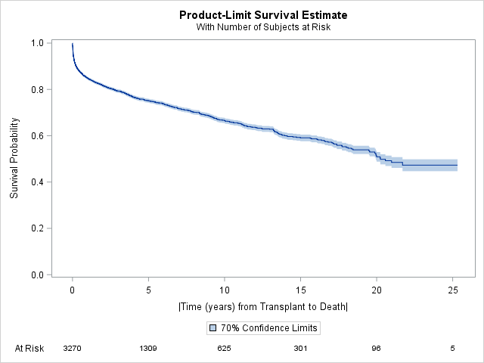
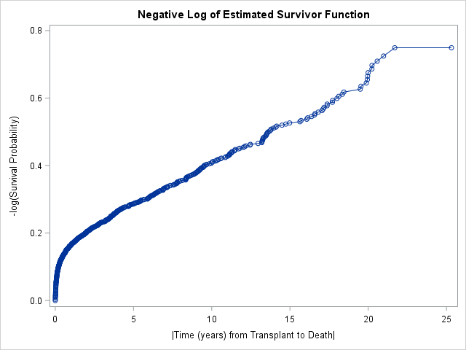
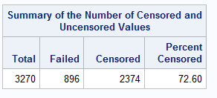
Survival and Cumulative Hazard

Slide 33
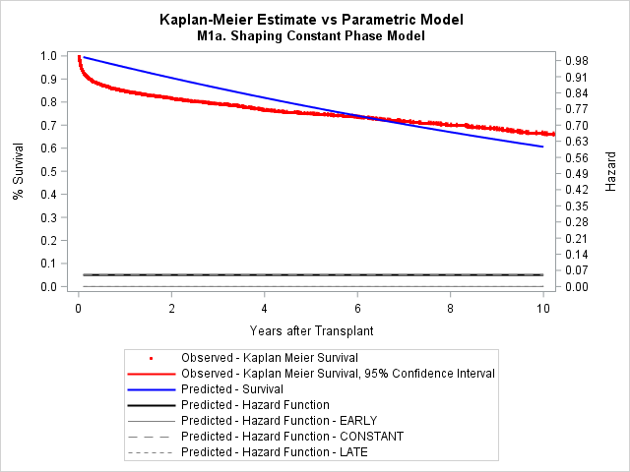
Constant Phase: Not a good fit

Slide 34
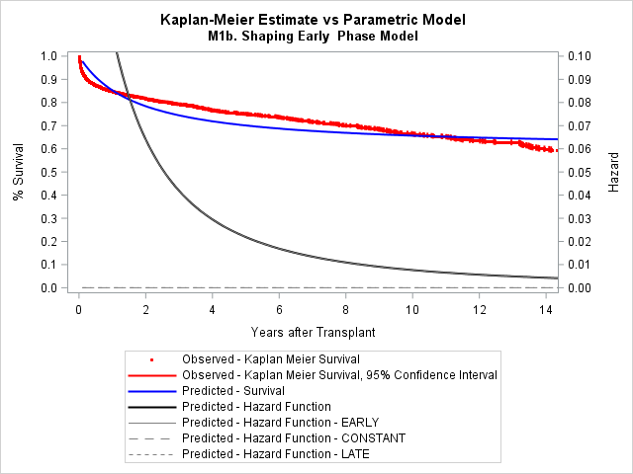
Early Phase: Not a good fit
Prior model used early phase only

Slide 35
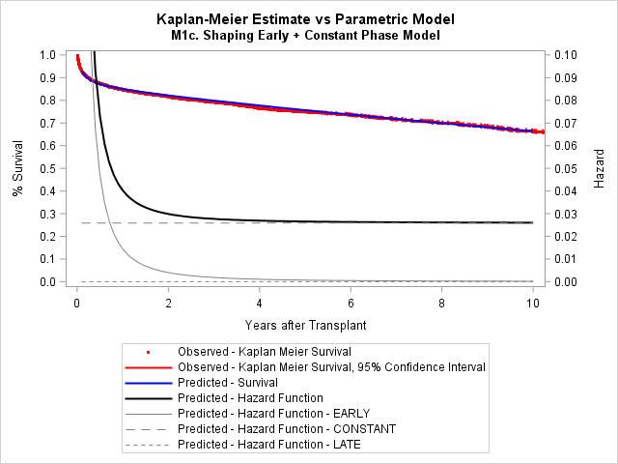
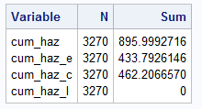
Early + Constan:t Model Used
Early + Constant Phase

Slide 36
Risk Factors Evaluated (Table Transplant Variables)
Creatinine at Transplant
Bilirubin at Transplant
ECMO at Transplant
VAD at Transplant
Gender
History of Renal Insufficiency
Donor Ischemic Time
Age at Transplant
Induction Therapy at Transplant
Heterotaxy Group
Renal Impairment (eGFR < 60) at Transplant
History of Surgery
Ventilator at Transplant
Race
Status 1 at Transplant
Inotropes at Transplant

Slide 37
Risk Model Results
PHASE | VARIABLE | VAR_LABEL | HR | LCL_95 | UCL_95 | P
Early | ECMO | ECMO at Transplant | 3.139 | 2.355 | 4.185 | <.0001
Early | VAD | VAD at Transplant | 1.566 | 1.049 | 2.338 | 0.0282
Early | MALE | Male | 0.807 | 0.654 | 0.996 | 0.0455
Early | INDTHER | Induction Therapy at Transplant | 0.548 | 0.442 | 0.680 | <.0001
Early | RENAL | Renal Failure at Transplant | 1.704 | 1.366 | 2.125 | <.0001
Early | TXVENT | Ventilator at Transplant | 1.379 | 1.078 | 1.763 | 0.0106
Constant | HETERO | Heterotaxy | 1.794 | 1.174 | 2.741 | 0.0069
Constant | HXSURG | History of Surgery | 1.536 | 1.179 | 2.003 | 0.0015
Constant | RRACE_B | Receipient Race - Black | 1.906 | 1.492 | 2.437 | <.0001
Constant | STATUS1 | Status 1 at Transplant | 0.573 | 0.459 | 0.716 | <.0001

Slide 38
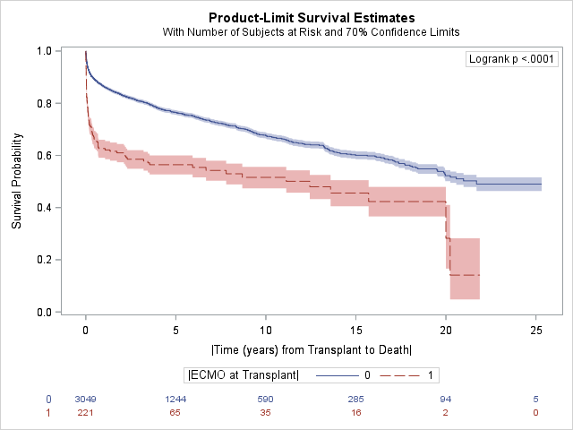
Risk Factor: ECMO

Slide 39
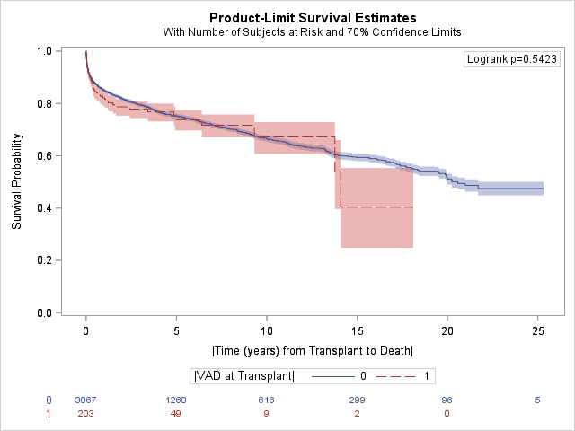
Risk Factor: VAD

Slide 40
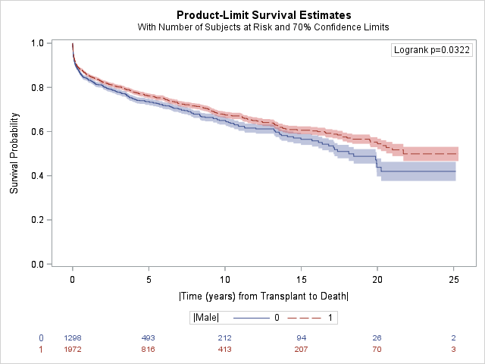
Risk Factor: Gender

Slide 41
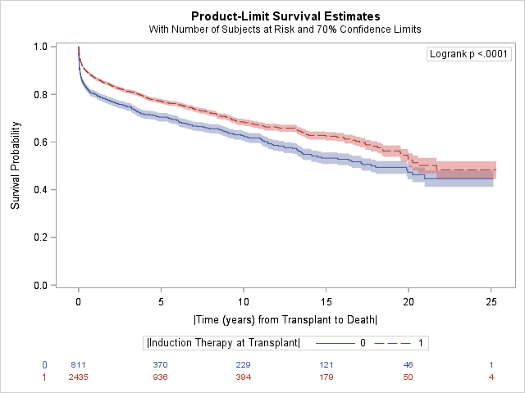
Risk Factor: Induction Therapy

Slide 42
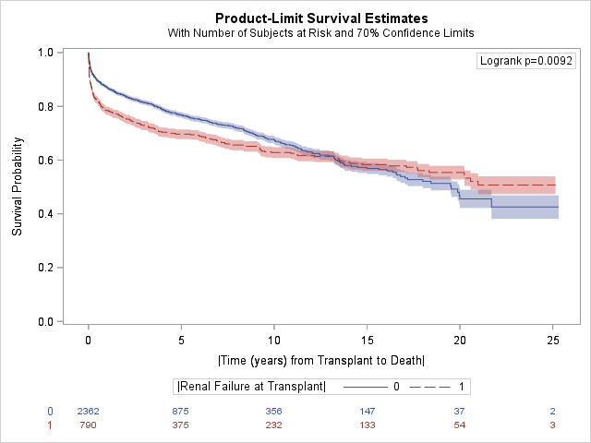
Risk Factor: Renal Failure (eGFR < 60)
Notes:
Renal dysfunction (eGFR < 60)

Slide 43
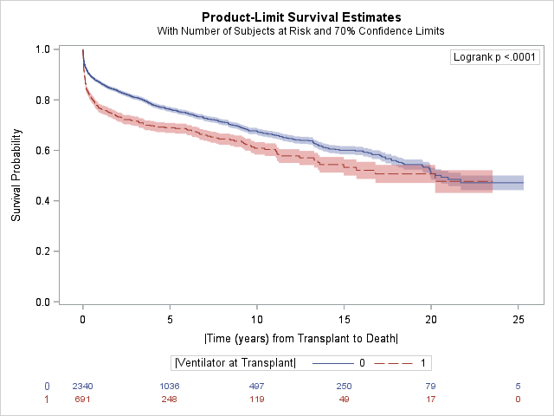
Risk Factor: Ventillator

Slide 44
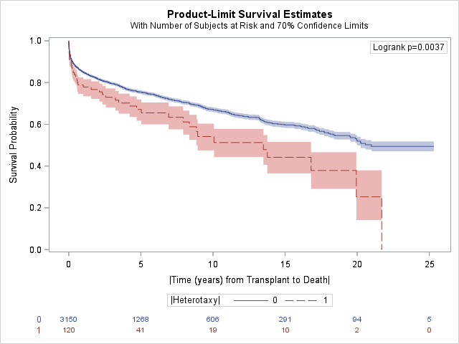
Risk Factor: Heterotaxy

Slide 45
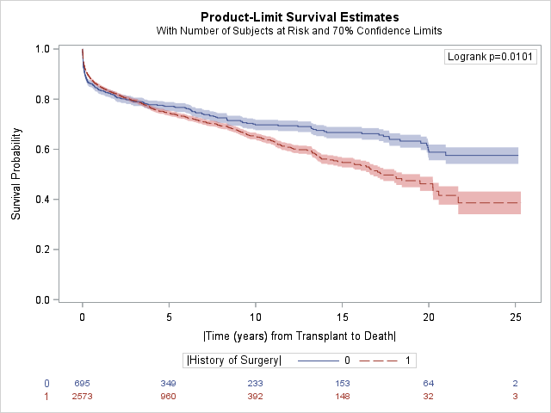
Risk Factor: History of Surgery

Slide 46
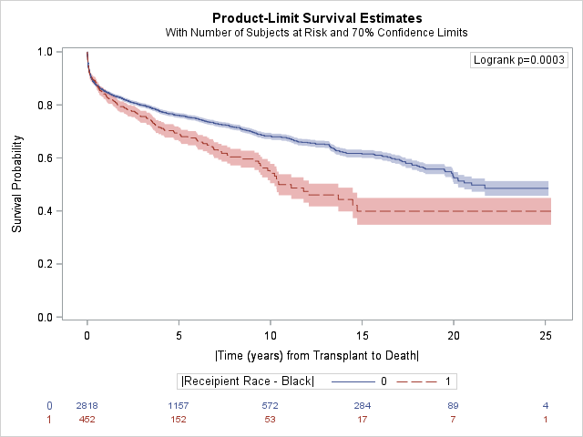
Risk Factor: Black Race

Slide 47
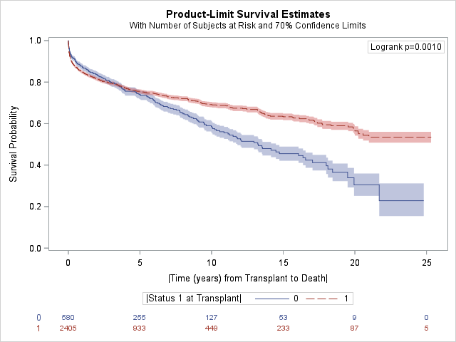
Risk Factor: Status 1

Slide 48
To Do
Update the analysis after registry wide CHD recode complete (Ask Susanna when this is anticipated)
Incorporate 30 day steroid use into model
Scott Auerbach paper Steroid Maintenance use
Kaplan-Meier by Heterotaxy status and Single ventricle status
Add Single Ventricle to tables and risk model
Ask Susanna about sub type of heterotaxy details
Heterotaxy type (look at KM and potential covariate)
Priority vs routine to tables and covariates
How is priority and routine defined?

